Slide 1
Comparing Catholic and the Orthodox Churches
Professor
Course Title
Date

Slide 2
Brief History
Orthodox: Summer of 1054 when it was born from Catholicism.
Result of the schism between the western church (Roman Catholic) and eastern church (orthodox).
Catholic Christianity date back to as early as first century; related to the inception of Christianity.
Wrangles between the two Christian groups include cultural clashes, political circumstances, papal claims, and the introduction of the Fili0que phrase into the Nicene creed.
Division at 1054 saw roman catholic center its operation on Pope of Rome; Orthodox church centered on Patriarch of Constantinople
Lived in formal isolation until recently; in 1965, Patriarch Athenagoras and Pope Paul VI mutually lifted the anathema charges.
Notes:
One summer’s afternoon in 1054, after testy exchanges with the Patriarch of Constantinople, the Pope’s representative, Cardinal Humbert, entered the city’s main place of worship, Hagia Sophia, placed a document on the altar, and then left quickly. The document was a Bull of Excommunication, expelling the recipients from the church and thereby denying them a route to heaven. This dramatic gesture is widely taken to mark the beginning of the ‘Great Schism’, the moment when the previously ‘undivided’ Church was split and Eastern Orthodoxy and Roman Catholicism were born. Wrangles between the two Christian groups include cultural clashes, political circumstances, papal claims, and the introduction of the Fili0que phrase into the Nicene creed. Patriarch Athenagoras and Pope Paul VI mutually lifted the anathema charges in 1965 as they sought to united the two groups.

Slide 3
Approach to the Bible
Cannon of scriptures for the orthodox is slightly different from the Roman catholic
Orthodox has additional parts; 1 Esdras, The Prayer of Manasseh in Chronicles, Psalm 151, 3 & 4 Maccabees.
Other parts of the bible are similar.
Interpretation is similar; difference not centered on the bible.
Catholic rejects the deuterocanonical books found in the orthodox bible and term them as apocrypha
Apocrypha; hidden things.
Notes:
While their interpretations of the scriptures is largely similar, the content differ in the two groups of Christianity. The orthodox church has additional parts which include 1 Esdras, The Prayer of Manasseh in Chronicles, Psalm 151, 3 & 4 Maccabees. The catholic church reject these books and term them as a apocrypha, which means hidden things.

Slide 4
Eucharist
In the orthodox church; Eucharist is a symbol of the forgiveness of sins
Termed as the mystic supper; an encounter with the risen Christ.
In catholic church, the Eucharist is similar to that of the orthodox; regarded as Holy sacrifice of the Mass.
Orthodox; priest call upon the Holy Spirit on the bread and wine; belief is that they change to actual body and blood of Christ; divine mystery.
Catholic church; the Priest, who acts in the person of Christ.
In both churches, the Eucharist is partaken only by the members of the church
Notes:
The Eucharist is symbolically different in the two churches; in orthodox, it termed as the mystic supper i.e. an encounter with the risen Christ. In catholic church, the Eucharist is similar to that of the orthodox; regarded as Holy sacrifice of the Mass. In the orthodox church, the priest call upon the Holy Spirit on the bread and wine with the belief that they change to actual body and blood of Christ in a divine mystery. As in Orthodoxy, the Priest invokes the Holy Spirit during the Mass. However, the consecration becomes effective through the Priest, who acts in the person of Christ. The gifts change completely into Christ's body and blood and this change is termed 'Transubstantiation' i.e. the outward appearance remains the same, but the substance changes.

Slide 5
Beliefs
Catholic church; for salvation, Christ has to die on the cross; a sacrifice to pay for the sins.
Sacrifice as a compensation for the damage caused in the relationship between God and man.
Orthodox church believe that there is no condition for acceptance back to God.
Orthodox perceives God as a loving father rather than a punisher.
no payment required to be accepted back by God.
The blood of Jesus was not to repair something; According to Anselm of Canterbury Christ had to comply until the end to save humanity.
Notes:
The Catholic church believes that for salvation to occur, Christ has to die on the cross as a sacrifice to pay for the sins of humanity. The sacrifice is a compensation for the damage caused in the relationship between God and man. Orthodox church believe that there is no condition for acceptance back to God. They perceive God as a loving father rather than a punisher and no payment is required to be accepted back by God. The blood of Jesus was not to repair something and according to Anselm of Canterbury Christ had to comply until the end to save humanity.

Slide 6
Beliefs Cont…
Nature of God
Orthodox takes God as the father; the tale of the prodigal son; does not matter if we are sinners or not.
Catholic church views the relationship with God as that of master and servant; tale of the workers
Catholic view; cause- effect relationship; for something to happen, there must be action.
Viewpoint on original sin
Catholic believe it is carried by all humanity; all guilty for what the first man did
In orthodox church, there is nothing as inherited sin; original sin is just a prototype of the sinful nature of man
Notes:
Regarding the nature of God, Orthodox church takes God as the father as depicted in the tale of the prodigal son. It does not matter if we are sinners or not. Catholic church views the relationship with God as that of master and servant is depicted in the tale of the workers. The Catholics use cause- effect relationship to explain their relationship with God. In the viewpoint of the original sin, the Catholics believe it is carried by all humanity and all guilty for what the first man did. In orthodox church, there is nothing as inherited sin, the original sin is just a prototype of the sinful nature of man.

Slide 7
Ethics
Orthodox church believe that marriage is a mystic union.
Divorce only allowed in cases of adultery; exceptions are there.
In catholic church, marriage is seen as an unbreakable contract; typical of Christ in the church; remarriage not allowed.
In orthodox, worship is solely centered on the divine liturgy
In catholic church, worship is centered on the procedural mass.
Both use the vernacular language in times of worship
Notes:
The Orthodox church believe that marriage is a mystic union with divorce only allowed in cases of adultery but there are exceptions. In catholic church, marriage is seen as an unbreakable contract. It depicts the relationship typical of Christ in the church and remarriage not allowed. In orthodox, worship is solely centered on the divine liturgy while Catholic church focuses on the procedural mass. Both use the vernacular language in times of worship

Slide 8
Beliefs About Mary
    In orthodox, Mary is venerated as Theotokos; meaning God bearer.
    She bore God in human form.
    The view is similar in Catholic church; title “mother of God” more prevalent than Theotokos
    Title is one of the Marian dogmas of the catholic church; others include immaculate conception, perpetual virginity.
    Orthodox church agrees that Mary experienced physical death but reject immaculate conception
    The catholic church is yet to decide whether Mary experienced physical death.
Notes:
In orthodox, Mary is venerated as Theotokos; meaning God bearer. She bore God in human form through Jesus Christ. The view is similar in Catholic church with the title “mother of God” more prevalent than Theotokos. Title is one of the Marian dogmas of the catholic church with others being include immaculate conception, perpetual virginity. Orthodox church agrees that Mary experienced physical death but reject immaculate conception.The catholic church is yet to decide whether Mary experienced physical death.

Slide 9
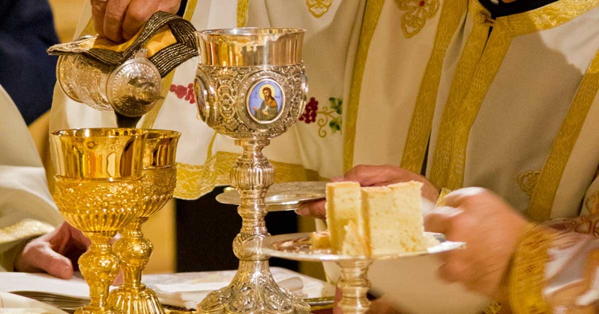
Rituals
Orthodox church has seven sacraments, but the list is not fixed.
Catholic church has its sacraments number fixed at seven
The sacrament known as Chrismation in orthodox church is replaced by the confirmation sacrament in the catholic church.
In both churches, the sacraments depicts mystical grace for those who participate in their partaking.
Notes:
The ritualistic events of the orthodox church involve seven sacraments but the number is not fixed, more are available. The catholic church has the same number of sacraments, which is fixed. The sacrament of Chrismation in orthodox church is replaced by the confirmation sacrament in the catholic church.

Slide 10
Pope
In orthodox church, the pope is recognized as the bishop of Rome
His authority is no greater than other bishops.
In catholic church, the pope is the vicar of Christ; the visible head of the church on earth; successor of St. Peter; has supreme authority regarding Christianity.
The Orthodox church rejects papal infallibility; the Holy Spirit is the guide to the church; recognize the first seven ecumenical councils as infallible.
In the Catholic church, the pope is infallible; defines doctrines of faith and morals.
Notes:
In matters of the pope, the orthodox church recognizes as the bishop of Rome. However, his authority is no greater than other bishops. In catholic church, the pope is the vicar of Christ, he is the visible head of the church on earth and spiritual successor of St. Peter. He has supreme authority regarding Christianity. The Orthodox church rejects papal infallibility and perceives the Holy Spirit as the guide to the church. They recognize the first seven ecumenical councils as infallible. In the Catholic church, the pope is infallible and defines doctrines of faith and morals.

Slide 11
Summary
Evident that Orthodox and catholic churches have contrasting characteristics and beliefs.
Despite their seemingly similar approach to worship, bible and the Eucharist.
Differences emanate in matters of the original sin where the Orthodox church fail to recognize the concept of sin inheritance.
There are also disagreements on Mary and her death as well as her immaculate conception.
Other beliefs are revealed such as salvation and the relationship between God and man.
In matters of ethics, marriage is perceived differently with the Catholic postulating it as an unbreakable union.
Notes:
It is evident that Orthodox and catholic churches have contrasting characteristics and beliefs. Despite their seemingly similar approach to worship, bible and the Eucharist. Differences emanate in matters of the original sin where the Orthodox church fail to recognize the concept of sin inheritance. There are also disagreements on Mary and her death as well as her immaculate conception. Other beliefs are revealed such as salvation and the relationship between God and man. In matters of ethics, marriage is perceived differently with the Catholic postulating it as an unbreakable union. The two groups of Christianity have been trying to make peace an unite as indicated in the mutual agreement to remove the anathema charges.

Slide 12
References
Cohen, W. (2017). The Concept of" sister Churches" in Catholic-Orthodox Relations Since Vatican II (Vol. 67). Wipf and Stock Publishers.
Doak, M. (2007). The politics of Radical Orthodoxy: A catholic critique. Theological Studies, 68(2), 368-393.
Hemming, L. P. (2017). Radical Orthodoxy?-A Catholic Enquiry. Routledge.
Tomka, M. (2006). Is conventional sociology of religion able to deal with differences between Eastern and Western European developments?. Social compass, 53(2), 251-265.

